Slide 1


Steroid-Refractory Acute Severe
Ulcerative Colitis in
Infliximab-Experienced Patients
Joana Revésª, Ana Catarina Bravoª, Catarina Neto Nascimentoª,
Bárbara Morãoª, Catarina Frias-Gomesª, Lídia Roque Ramosª, Luísa Glóriaª,
Joana Torres^{a, b}, Carolina Palmelaª
ª Gastroenterology Department, Hospital Beatriz Ângelo, Loures, Portugal;
^{b} Faculty of Medicine, University of Lisbon, Lisbon, Portugal
Published online: March 21, 2024

Slide 2
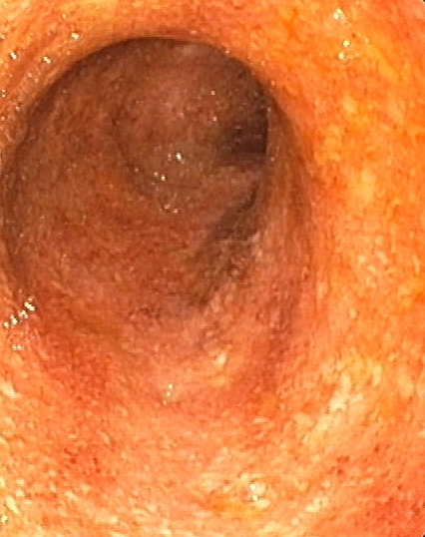
Background
Narrative review
Acute severe ulcerative colitis (ASUC) is a potentially life-threatening complication of ulcerative colitis (UC) that can lead to significant morbidity and mortality;
Infliximab (IFX) and cyclosporine (CyA) are the sole-approved drugs for rescue medical therapy in patients with ASUC after steroid failure;
IFX has also been increasingly used as an induction and maintenance therapy in patients with moderate-to-severe UC.
The number of patients admitted with ASUC previously exposed to IFX has been increasing, raising additional challenges in the medical management of these patients to avoid emergent colectomy.

Slide 3
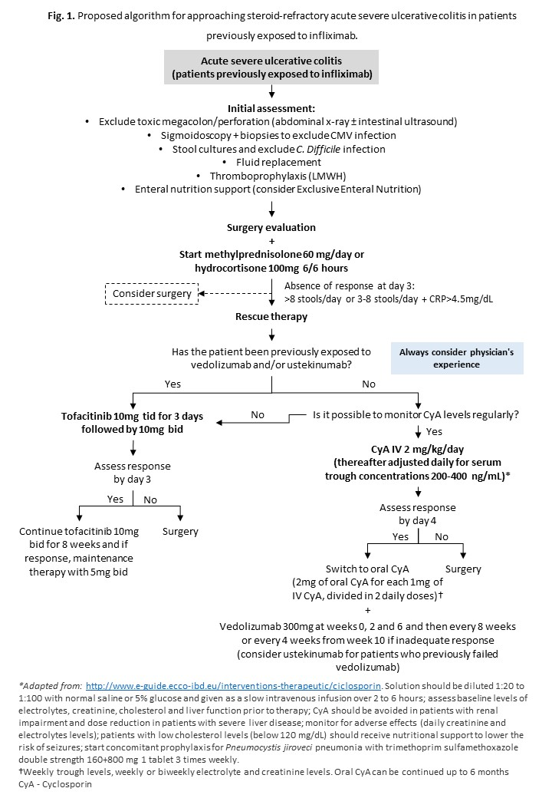



Main findings
Narrative review
Two medical approaches may be considered for steroid-refractory ASUC in IFX-experienced patients:
To induce remission with CyA and then transition to another biologic such as vedolizumab or ustekinumab
To use tofacitinib for both induction and maintenance of remission.
Choice dependent on local policies, physician’s experience, and patient’s medical history.
Multidisciplinary medical-surgical approach, with surgery always considered in more refractory cases.

