Slide 1


Non-Invasive versus Invasive Assessment of Portal Hypertension in Chronic Liver Disease
Rui Gaspar^{a,b}, Guilherme Macedo^{a,b}
ª Gastroenterology and Hepatology Department, ULS São João, Porto, Portugal;
^{b} Faculty of Medicine, University of Porto, Porto, Portugal
Published online: April 22, 2024

Slide 2
Background
Narrative review
Cirrhosis is one of the major causes of morbidity and mortality worldwide;
Portal Hypertension is the main driver for development of cirrhosis-related complications (ascites, variceal bleeding) and is defined as an hepatic venous pressure gradient (HVPG) > 5 mmHg
Detection of clinically significant portal hypertension (CSPH) in chronic advanced liver disease is essentail for guiding the management of these patients and to improve prognosis

Slide 3
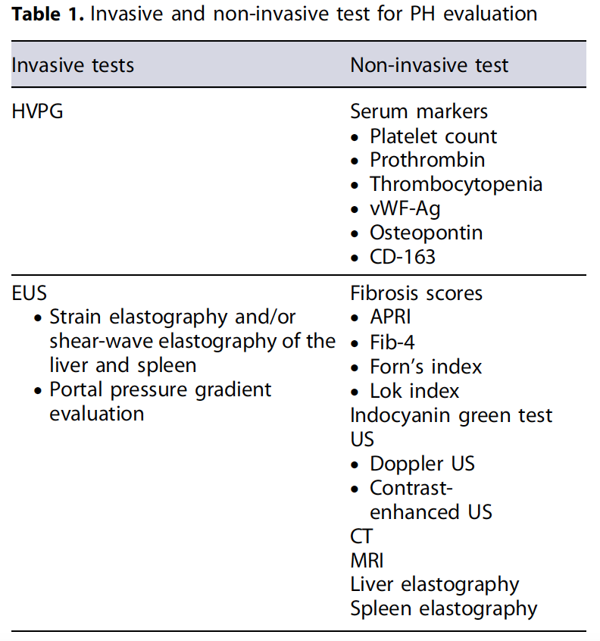


Main findings
Narrative review
Two main approaches for measurement of HVPG:
Non-invasive: serum markers, fibrosis scores, ultrasound, CT, MRI, liver and spleen elastography
Invasive: HVPG through catheterization of hepatic veins or through endoscopy ultrasound.
HVPG measurement through catheterization of hepatic veins is the gold-standard but has some limitations .
Liver and spleen elastography are the most promising non-invasive tools for a correct determination of HVPG

